Slide 1
Prediction of Heart Disease Risk from ECG Images Using CNN
Chalini M
2023BCSE07AED440
B.Tech CSE (AI & ML)
Dataset: ECG Heartbeat Categorization (Kaggle)

Slide 2
Problem Statement
Heart disease is a leading global cause of death.
Early detection can save lives.
ECG images provide vital information on heart activity.
Manual analysis is slow and prone to human error.
Goal: Automate ECG classification using CNN-based AI model.

Slide 3
Objectives
Prepare and clean ECG image dataset.
Design CNN models using different activation functions.
Train and optimize models using backpropagation.
Evaluate model performance with key metrics.
Visualize and compare results for improvement.

Slide 4
Dataset Description
Source: Kaggle – ECG Heartbeat Categorization Dataset.
Classes: Normal ECG, Abnormal ECG.
Data Split: 80% training, 20% testing.
Preprocessing Steps:
Resized to 128×128 pixels.
Normalized pixel values between 0 and 1.
Data augmentation (rotation, flip, zoom).

Slide 5
Algorithm Overview
Model: Convolutional Neural Network (CNN).
Key Layers: Convolution + ReLU, MaxPooling, Flatten, Dense, Output (Sigmoid).
Optimizer: Adam.
Loss Function: Binary Cross-Entropy.
Frameworks: TensorFlow / Keras.

Slide 6
Activation Functions Tested
ReLU – Best performance, fast convergence.
Sigmoid – Smooth output, slower training.
Tanh – Moderate accuracy, stable.
Leaky ReLU – Avoids neuron inactivity.
Conclusion: ReLU achieved the highest accuracy among all.

Slide 7
Model Training and Backpropagation
Backpropagation minimizes loss by adjusting weights.
Each epoch reduces model error and improves accuracy.
Fine-tuning learning rate and activation functions enhanced performance.
Adam optimizer used for efficient gradient updates.

Slide 8
Performance Evaluation
Metrics: Accuracy, Precision, Recall, F1-Score.
Confusion Matrix shows correct vs. incorrect predictions.
Results:
– ReLU model achieved >90% accuracy.
– Balanced precision and recall.
– Data augmentation reduced overfitting.

Slide 9
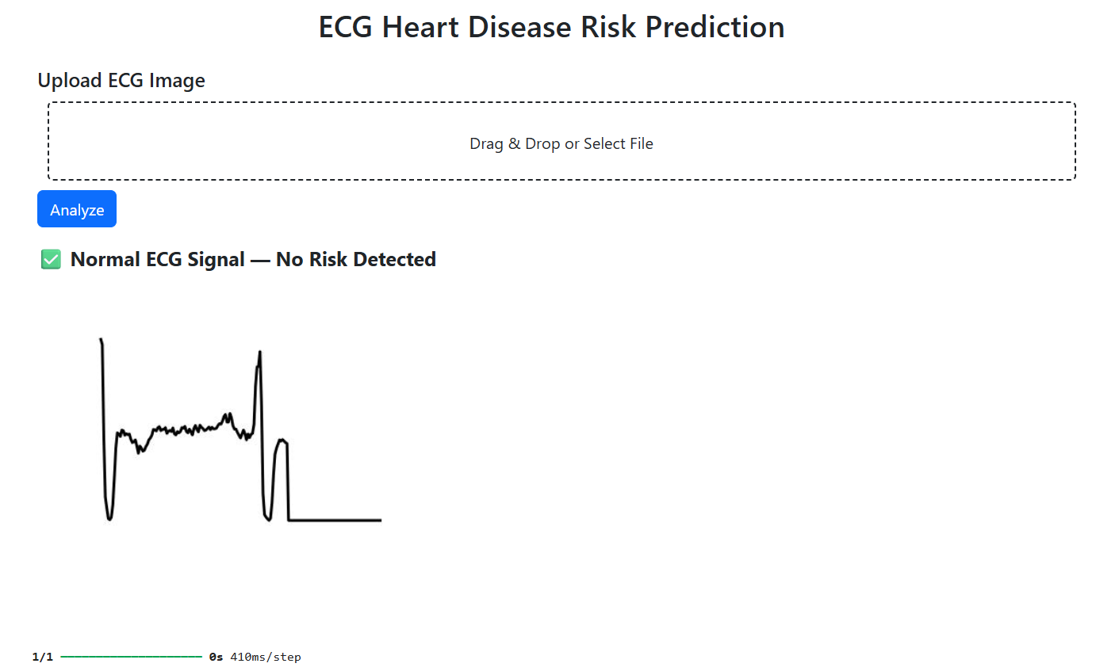
Output

Slide 10
Comparison with Other Methods
Activation Function | Accuracy | Remarks
Sigmoid | 82% | Slower learning.
Tanh | 85% | Stable but moderate
Leaky ReLU | 88% | Good stability
ReLU | 92–94% | Fastest and most accurate

Slide 11
Future Enhancements
Use larger, more diverse ECG datasets.
Combine CNN with LSTM for sequence learning.
Deploy as a real-time heart monitoring system.
Integrate explainable AI for medical transparency.
Develop a cloud-based application for hospitals.

